Slide 1

Recombinant Expression Simulation: Theoretical Background
The BioLabSim.nrw consortium

Slide 2
Outline
Theory
Microbial Growth
Growth Phenotypes
Mathematical Models
High-Throughput Measurements
Biotechnological Relevance
Bacterial Gene Expression
Expression factors
Contribution to expression strength
Expression Strength Prediction
Simulation
Life presentation of the simulation

Slide 3
Teaching Objectives
Distinguish a suitable growth law for data analysis.
Knowledge of growth types
Knowledge of equations and their variables
Identify factors of gene expression on a DNA sequence.
Knowledge of expression factors
Judge whether a phenomenon is better described by a mechanistic or statistic model.
Knowledge of modelling principles

Slide 4
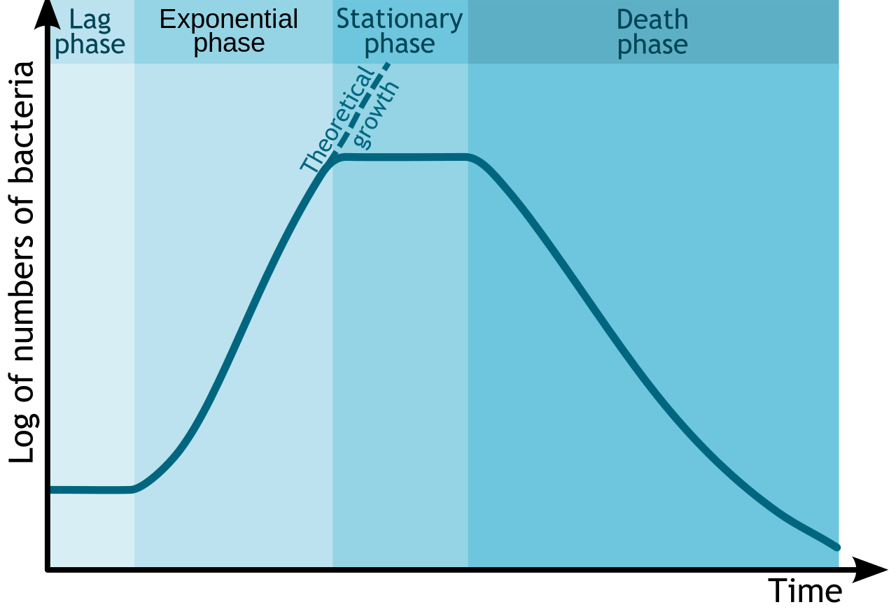
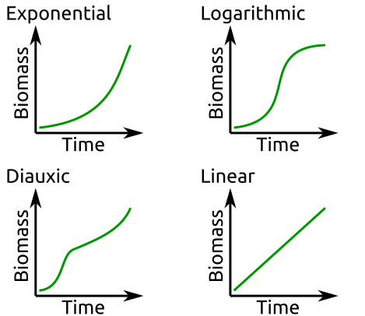
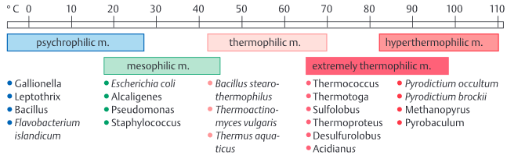
Microbial Growth Phenotypes
Environmental conditions determine growth rate:
Temperature, Substrate, pH, etc.
Growth is separated in different phases
In non-optimal conditions and environmental changes microorganisms adapt their growth.
Michał Komorniczak, https://en.wikipedia.org/wiki/Bacterial_growth#/media/File:Bacterial_growth_en.svg
Schmid, Schmidt-Dannert, Hammelehle (2014) Biotechnology, An illustrated primer, ISBN-10: 9783527335152

Slide 5
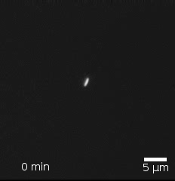
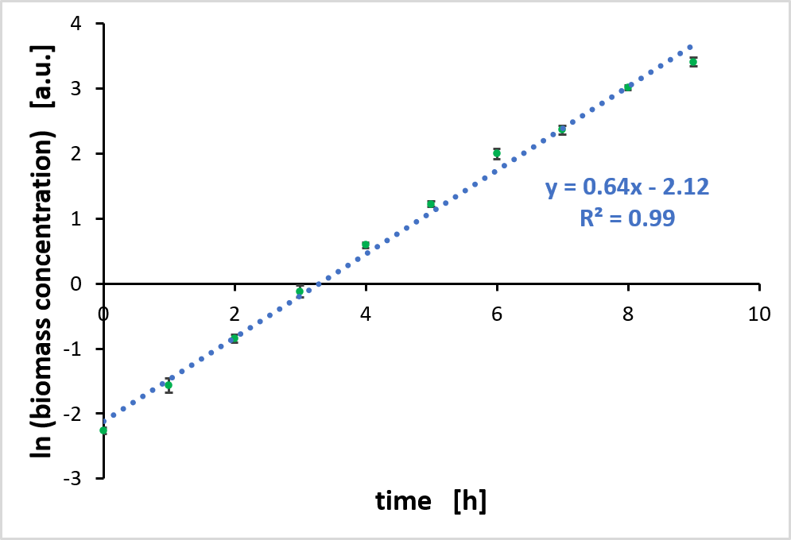

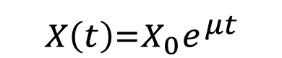
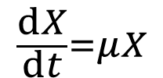
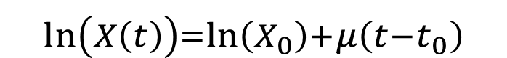
Growth Models: The Exponential Function
In optimal conditions microorganisms growth exponentially
Many processes initially follow exponential dynamics:
Covid19 spread, Computing power, etc.
Growth rate remains constant.
Mechanistic Growth Model:
Stewart EJ, Madden R, Paul G, Taddei F (2005) (https://commons.wikimedia.org/wiki/File:E.coli-colony-growth.gif), https://creativecommons.org/licenses/by-sa/4.0/legalcode
$$X\underset{→}{μ}2X$$
X: Biomass, gDW/L
μ: growth rate, /h
t: time, h
$$\frac{dX}{dt}=μX$$
$$X\left(t\right)=X_{0}e^{μt}$$
$$ln\left(X\left(t\right)\right)=ln\left(X_{0}\right)+μ\left(t−t_{0}\right)$$

Slide 6
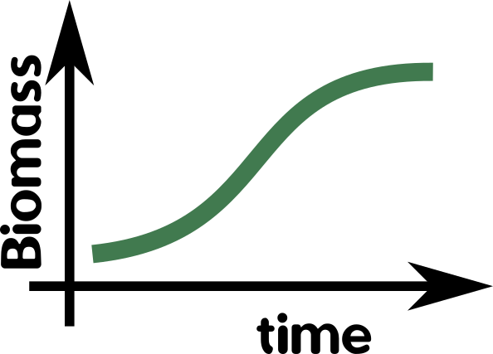
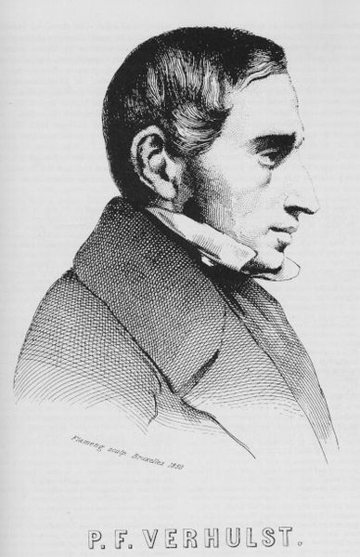
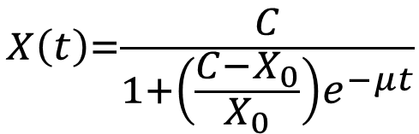
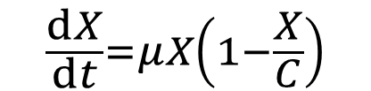
Growth Models: The Logistic Function
Environmental capacity limits cause transition from exponential to logistic growth.
Capacity limits: substrates, space, waste accumulation, etc.
Growth rate remains constant
X: Biomass, gDW/L
μ: growth rate, /h
C: capacity limit, gDW/L
t: time, h
$$\frac{dX}{dt}=μX\left(1−\frac{X}{C}\right)$$
$$X\left(t\right)=\frac{C}{1+\left(\frac{C−X_{0}}{X_{0}}\right)e^{−μt}}$$
Growth rate is estimated with parameter search to minimize error.
source: Pierre Francois Verhulst.jpg, https://commons.wikimedia.org/w/index.php?title=File:Pierre_Francois_Verhulst.jpg&oldid=141824277

Slide 7
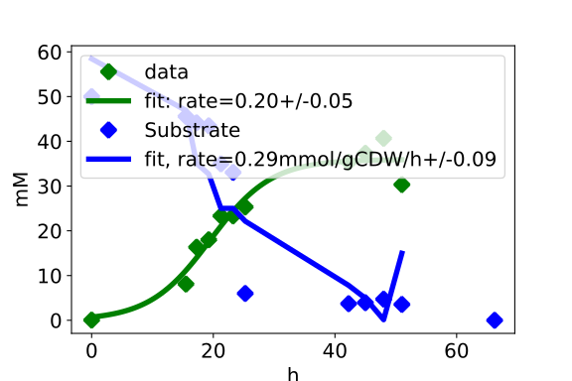
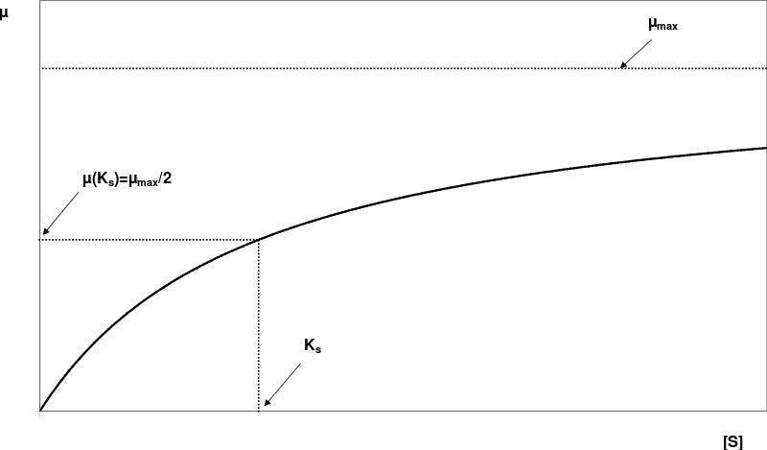
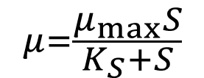
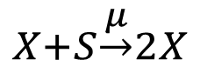
Growth Models: The Monod Equation
Growth rate is variable and depends on environment, e.g. substrate level, temperature.
Monod assumed that growth is substrate limited by enzymatic actions.
Similar to Michaelis-Menten equation.
$$X+S\underset{→}{μ}2X$$
$$μ=\frac{μ_{max}S}{K_{S}+S}$$
μ: growth rate, /h
μ _{max}: max rate, /h
S: substrate, mM
K_{S}: substrate affinity, mM
Substrate measurements required for parameter estimation.
File:Monod 3.svg, https://commons.wikimedia.org/w/index.php?title=File:Monod_3.svg&oldid=427056782 (last visited April 20, 2022).

Slide 8
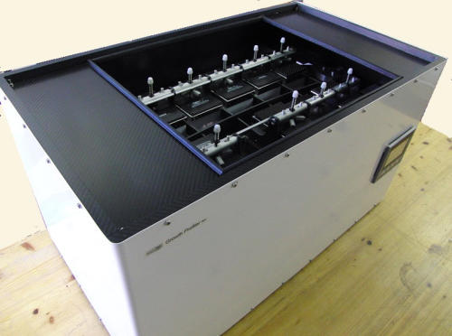
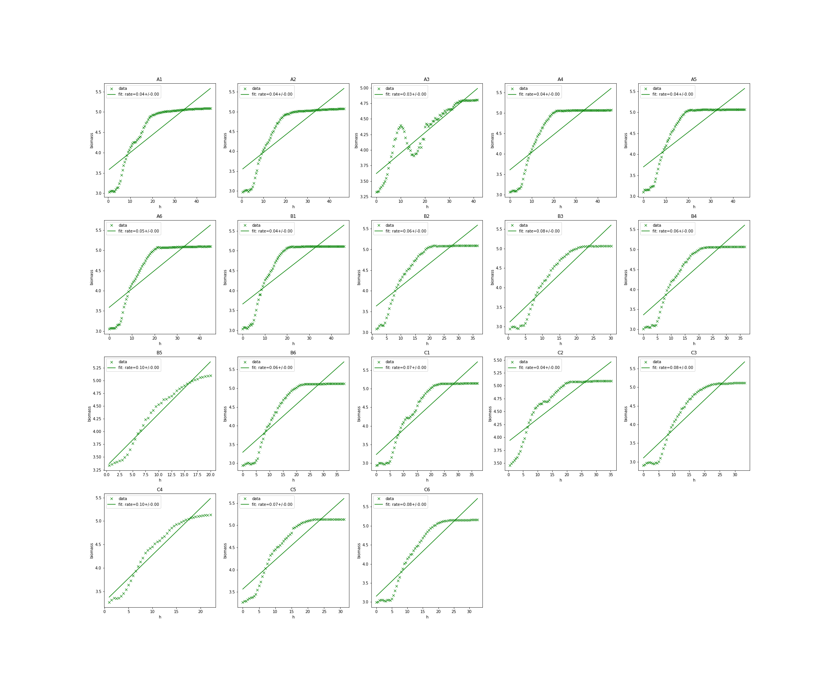
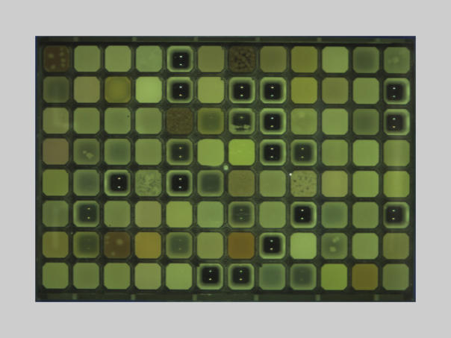
High-Throughput Measurements
Organisms with high growth rates need to be selected based on mutations and medium.
96-well plate measurement of growth by Enzyscreen GrowthProfiler
Data export as csv-files
Automated analysis in Jupyter Notebooks
Source: https://www.enzyscreen.com/growth_profiler.htm

Slide 9
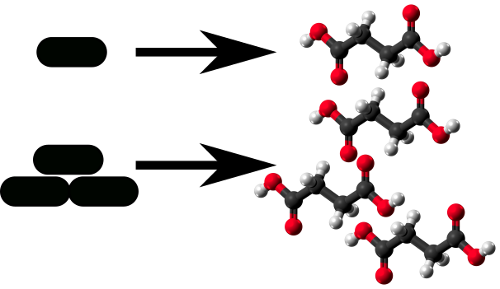
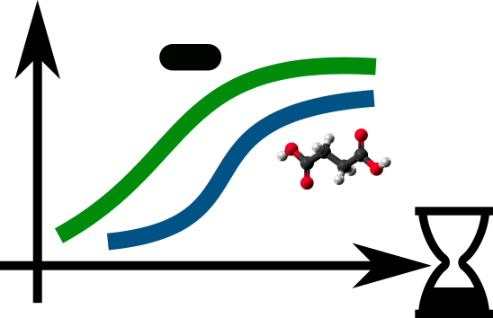
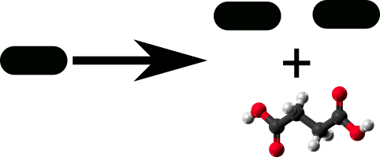

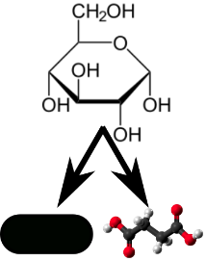


Biotechnological Relevance
Target products produced in different growth phases.
Growth-coupled production enables optimization with ALE.
High cell densities lead to high productivity.
Efficiency tradeoff by substrate use in biomass and product.
Optimal growth requires energy for heating/cooling.
Biomass waste disposal strategy for GMOs.

Slide 10






Growth Curve Data Analysis Example
Objective
Optimal
Temperature
Growth Rate &
Max Biomass
Procedure
Analysis
Scrambled code-lines provided
User rearranges line order for functional code
Standard for quick laboratory data analysis.
Users implement Excel linear regression.

Slide 11
Excel-basee Growth Rate Calculation
Determine mean value and standard deviation (only necessary for biological replicates)
Plot the Logarithm of biomass concentrations against time
Perform a linear regression with the linear range
→ The slope of the regression line is equal to the growth rate
Example cultivation from BioLabSim at 35 °C. Shown is the mean value and the standard deviation of three biological replicates.

Slide 12
Python-based Growth Rate Calculation
Rearrange code lines
Extract the highest growth slope for ln(biomass)
Extract the range of linear slope for ln(biomass)
Rearrange code lines for linear regression and max biomass extraction
# Rearrange the correct code sequence for plotting the growth curves with the logarithm of biomass.
Time, Biomass = my_data[:,0], my_data[:,1:]
DataFile = 'Strain_characterization_1.csv'
LnBiomass = np.log(Biomass)
plt.scatter(Time, X, label=Exp) for Exp,X in enumerate(LnBiomass.T)]
plt.legend(bbox_to_anchor=(1.05, 1), loc='upper left')
my_data = np.genfromtxt(DataFile, delimiter=',', skip_header=1)

Slide 13
Outline
Theory
Microbial Growth
Growth Phenotypes
Mathematical Models
High-Throughput Measurements
Biotechnological Relevance
Bacterial Gene Expression
Expression factors
Contribution to expression strength
Expression Strength Prediction
Simulation
Life presentation of the simulation

Slide 14
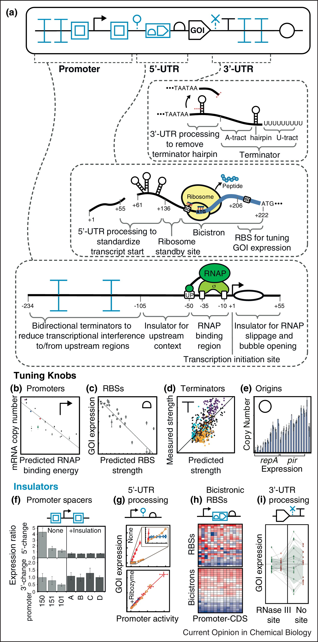
Bacterial Gene Expression
Three levels of gene expression regulation:
Transcription initiation by the promoter
Translation initiation by the 5’ UTR
mRNA stability by the 3’ UTR
Nielsen, A., Voigt, C. (2013).
Advances in genetic circuit design: Novel biochemistries, deep part mining, and precision gene expression.
Current Opinion in Chemical Biology, 17(6), 878–892. doi: 10.1016/j.cbpa.2013.10.003

Slide 15
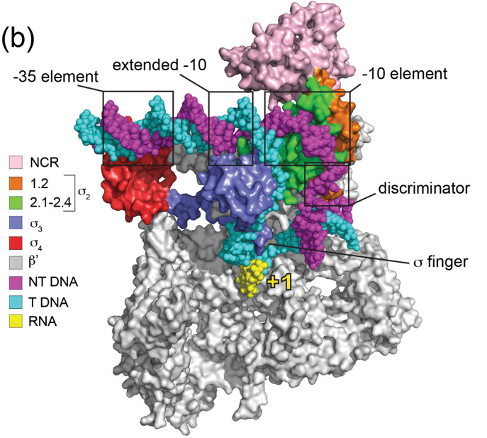
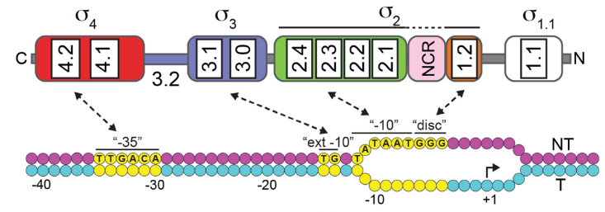
Sigma Factors and Sequence Boxes
The RNA-polymerase function is extending a nucleotide sequence based on homology.
A σ-factor guides the RNA-polymerase to the promoter of a gene.
Different σ-factors have different recognition sequences and expression efficiencies.
A useful biotechnical used σ−factor in E. coli and P. putida is σ70.
Important σ70 recognition sites are the boxes:
-35: TTGACA
-10: TATAAT
M.S. Paget (2015). Bacterial Sigma Factors and Anti-Sigma Factors: Structure, Function and Distribution
Biomolecules, 5(3), 1245–65. doi: 10.3390/biom5031245

Slide 16
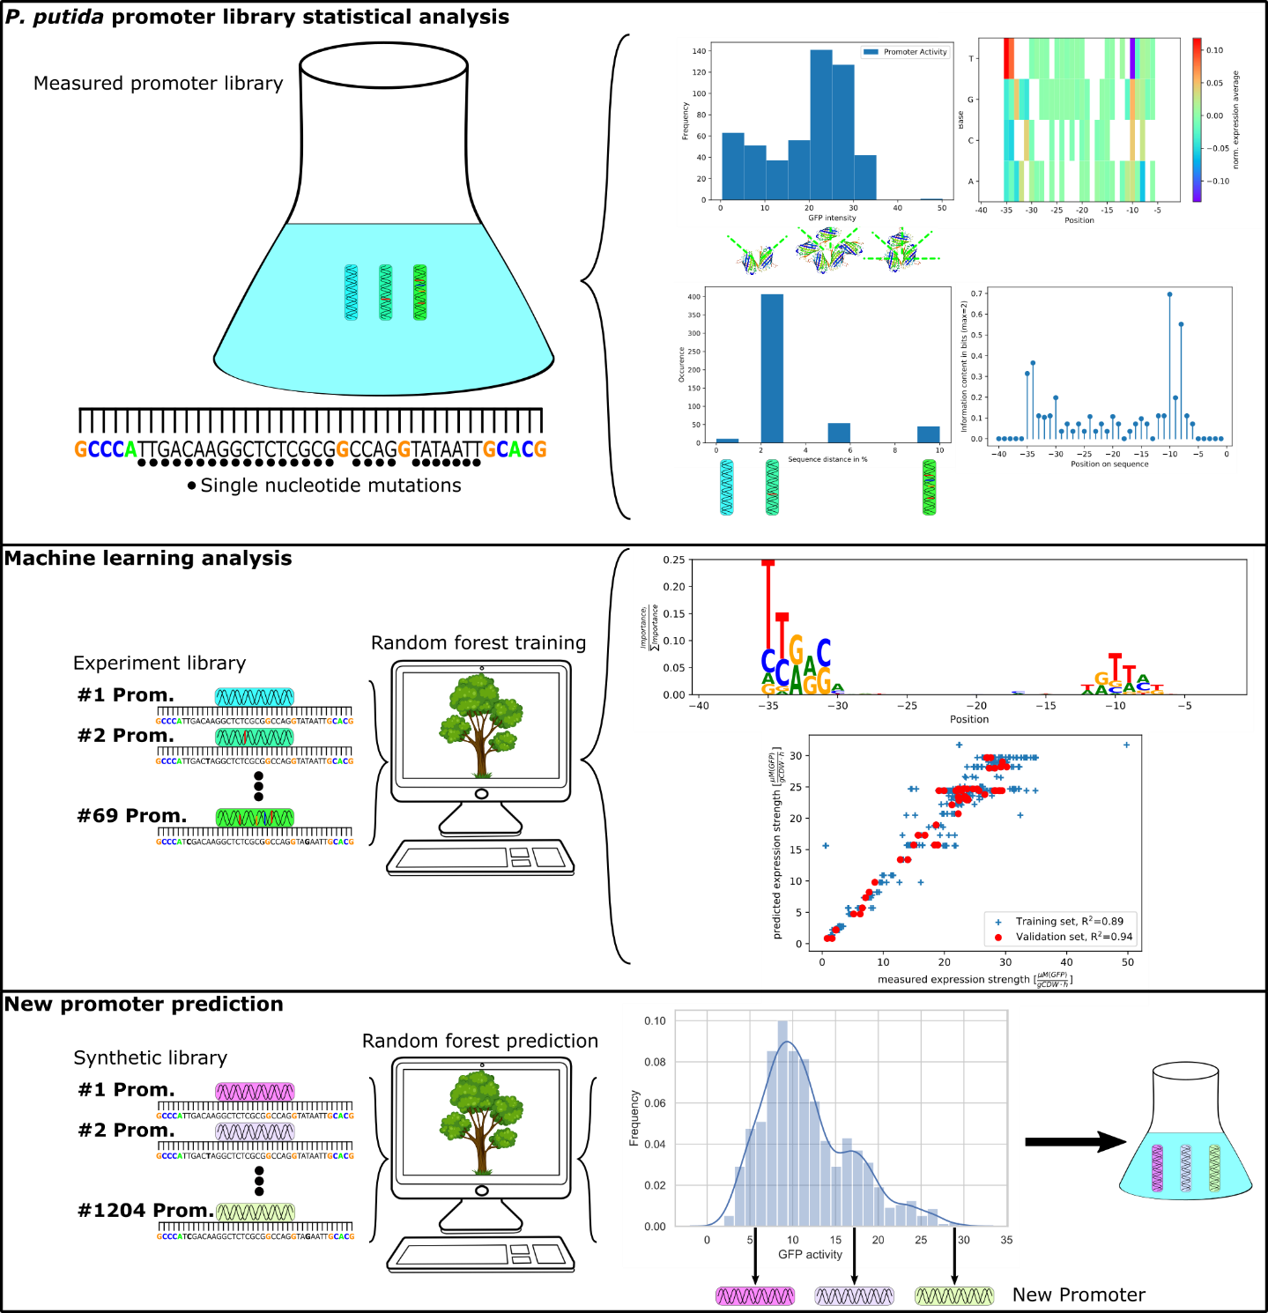
The Random Forest – Applications
Promoter Library Analysis
Promoter library with mutations in promoter sequence and GFP activity.
RF-Learning with sequence as binary input, and additional variables, e.g., GC-content.
Output is GFP activity.
Prediction quality control with R² and RMSE
Variable importance: nucleotide contribution to the prediction.
Identification of novel strong promoters.
U. Liebal et al. (2021) Insight to Gene Expression From Promoter Libraries With the Machine Learning Workflow Exp2Ipynb.
Front. Bioinform., doi: 10.3389/fbinf.2021.747428

Slide 17
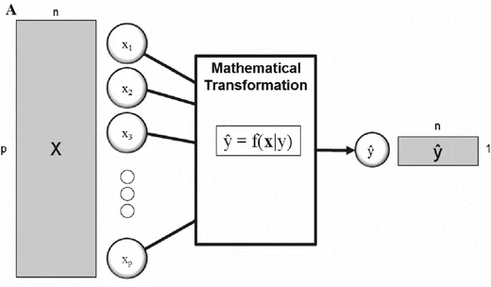
Principles of Regression
Variables
Statistical (Machine learning)
Vs
Mechanistic modeling
Observations
Regression:
Prediction of continuous observations with variables.
Mathematical transformation:
Statistical modeling with generic formula (machine learning, AI).
Mechanistic modeling with biological interactions and laws.
D. I. Broadhurst and D. B. Kell, doi: 10.1007/s11306-006-0037-z
Examples
Statistical Model
X: Sequence Library with mutations in promoter region
Y: Expression rate, measured with GFP
Regression model: Random Forest
Mechanistic Modeling
X: time of culture growth
Y: Biomass
Regression model: Logistic Function

Slide 18
Promoter Activity Prediction with Random Forest
Automated method for classification and regression.
Most famous as ‘CART: Classification And Regression Tree’ by Leo Breiman, 1984.
Visually ordered overview to formal rules.
Binary rules at roots lead to leave-outcomes.
A decision tree can be generated automatically via machine learning.
Wurzelknoten
Feature A?
Ja
Nein
Hoch
Feature B?
Ja
Nein
Hoch
Niedrig
Blätter

Slide 19
Construction of a decision tree
Name | Position 1 2 3 4 |  |  |  | Expr. Level
Lactase | A | G | T | A | Niedrig
ADH | A | C | T | G | Hoch
XYZ | A | T | G | C | Hoch
MNO | A | G | T | A | Niedrig
Step 1: determine starting root
Effective separation at position 3.
If: Pos3 = ‘G’ then expression High.
Else: different level of expression → no clear decisions
Step 2: data separation
If: Pos.4 = ’G’ then expression High.
Else: expression Low.
Pos.3 = G
Ja
Nein
The expression of all sequences can be determined following the roots to the leafes.
Hoch
Pos.4 = G
XYZ
Ja
Nein
Hoch
Niedrig
ADH
Lactase
MNO

Slide 20
Outline
Theory
Microbial Growth
Growth Phenotypes
Mathematical Models
High-Throughput Measurements
Biotechnological Relevance
Bacterial Gene Expression
Expression factors
Contribution to expression strength
Expression Strength Prediction
Simulation
Life presentation of the simulation

Slide 21
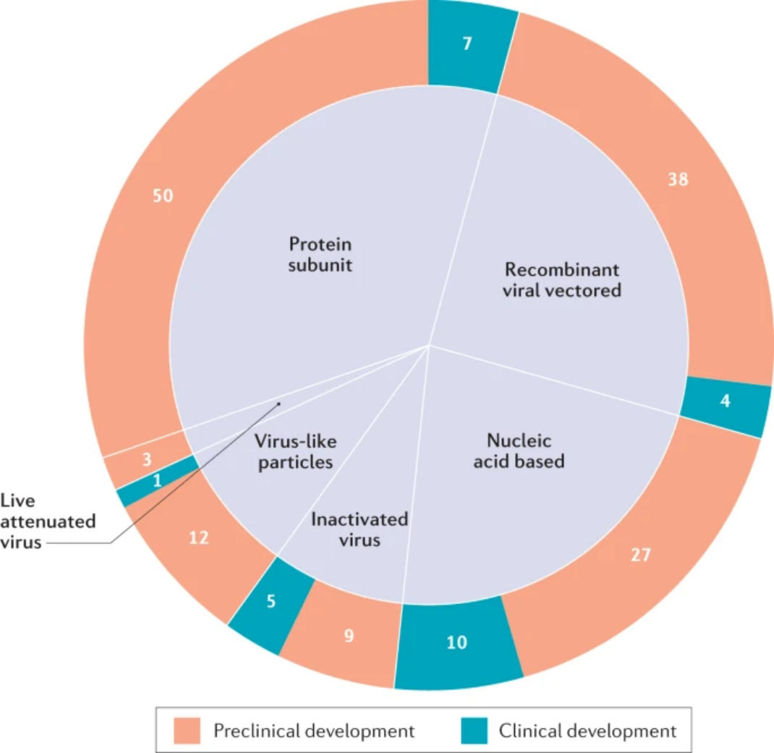
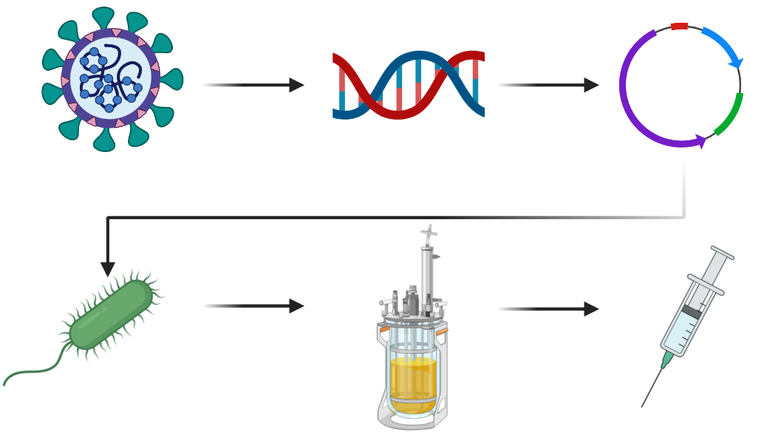
Simulation of Recombinant Expression
Develop an expression system for recombinant production of COVID19 protein subunits for vaccination.
Your tasks:
1. Characterize two strains for their growth properties
2. Generate promoter sequences
3. Clone promoter sequences into strain
4. Measure expression rate
5. Conduct batch fermentation to harvest protein subunits
Source: Jeyanathan et al., 2020, https://doi.org/10.1038/s41577-020-00434-6
The majority of vaccine (candidates) is based on recombinant expression of protein subunits.

Slide 22

Authors and License
Check the BioLabSim.nrw members at:
https://git.rwth-aachen.de/ulf.liebal/biolabsim/-/blob/91dd40b2f40e6a24263af96c2d5b9817733f4a25/AUTHORS.md
All material in this lecture is free to use, adapt and distribute according to CC BY 4.0 citing:
Ulf Liebal, BioLabSim.nrw consortium, RecExpSim Lecture, 2022, https://git.rwth-aachen.de/ulf.liebal/biolabsim

